Slide 1
HAND WRITTEN DIGIT RECOGNITION USING
GENERATIVE ADVERSARIAL NETWORK
Presented By: J.Abarna
Register No : 912221104001
Department : Computer Science And Engineering
3/21/2024 Annual Review

Slide 2
PROJECT TITLE
HAND WRITTEN DIGIT RECOGNITION USING
GENERATIVE ADVERSARIAL NETWORK
3/21/2024 Annual Review

Slide 3


AGENDA
111
1.Problem Statement
2.Project Overview
3.End Users
4.Our Solution And Proposition
5.Key Features
6.Modelling Approach
7.Results and Evaluation
8.Conclusion
3/21/2024 Annual Review

Slide 4

PROBLEM STATEMENT
Inefficient handwritten text recognition persists due to the scarcity of diverse
datasets and the complexity of individual writing styles. To address this, leveraging
Generative Adversarial Networks (GANs) offers a promising avenue.
Our project aims to harness GANs to generate realistic handwritten characters, facilitating data augmentation for improved model training.
.
By bridging the gap between synthetic and real-world handwritten samples, our approach seeks to enhance the accuracy and robustness of handwritten text recognition systems.
Through this research, we aim to revolutionize handwritten text processing, enabling more efficient and accurate recognition across variousapplications and industries.
3/21/2024 Annual Review

Slide 5

PROJECT OVERVIEW
The Handwritten Digit Recognition using Generative Adversarial Network (GAN) project aims to develop a robust system capable of accurately identifying and classifying handwritten digits.
Leveraging the power of deep learning and GANs, this project seeks to provide a solution that can improve the accuracy and efficiency of digit recognition tasks.
such as those encountered in optical character recognition (OCR) systems and digit-based classification problems.
3/21/2024 Annual Review

Slide 6

WHO ARE THE END USERS?
Companies and Organizations
Reseachers and developers
General Users
Educational Institutions
Medical Professionals
Government Agencies
3/21/2024 Annual Review

Slide 7

YOUR SOLUTION AND ITS VALUE PROPOSITION
Our solution for Handwritten Digit Recognition using Generative Adversarial Network (GAN) employs cutting-edge deep learning techniques to accurately identify and classify handwritten digits.
By leveraging the power of GANs, our system generates realistic handwritten digit images, which are then used to train a convolutional neural network (CNN) for digit recognition.
We develop a CNN model for digit recognition, trained using both real and generated handwritten digit images.
3/21/2024 Annual Review

Slide 8

THE WOW IN YOUR SOLUTION
Real-time Feedback and Iterative Improvement
Style Transfer and Adaptability for Handwritten Digit Recognition
Experience the future of digit recognition with our Handwritten Digit Recognition solution using Generative Adversarial Network
Say goodbye to data scarcity woes!
3/21/2024 Annual Review

Slide 9
MODELLING
GENERATIVE ADVERSARIAL NETWORK(GAN)
1.A Generative Adversarial Network (GAN) is a class of machine learning
frameworks introduced by Ian Goodfellow and his colleagues in 2014.
2.GANs are composed of two neural networks, a generator and a discriminator,
which are trained simultaneously through adversarial training.
DATA PREPROCESSING
1.Normalize pixel values of handwritten digit images to a standardized scale (e.g., [0, 1]) for uniformity.
2.Split dataset into training and testing sets, ensuring a representative distribution of digit samples in each set.
3/21/2024 Annual Review

Slide 10
TRAINING PROCESS
Explain the training process of the GAN model, emphasizing the adversarial training approach where the generator learns to produce realistic handwritten characters while the discriminator learns to differentiate between real and synthetic samples
FINE TUNING AND REGULARISATION
Fine-tuning involves adjusting the hyperparameters and network architecture of the GAN model to optimize its performance further.
Regularization techniques are applied to prevent overfitting and improve the generalization ability of the GAN model.
MODEL EVALUATION
Measure the accuracy of the GAN-generated handwritten digit images in resembling real handwritten digits.
Evaluate the performance of the digit recognition model trained using the GAN-generated images.

Slide 11
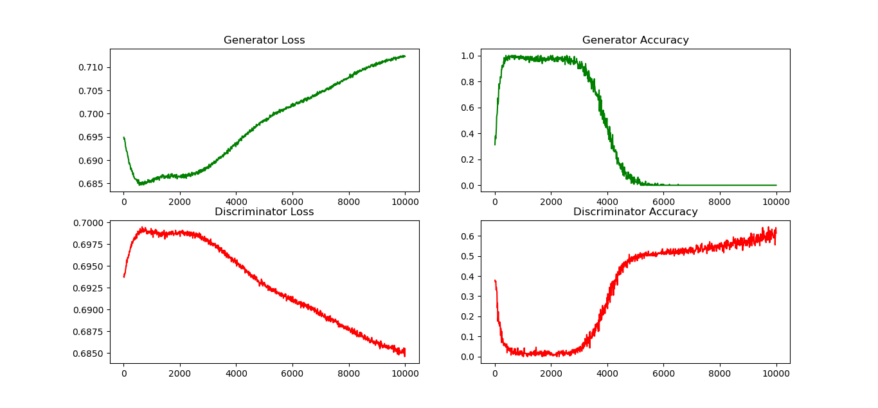
RESULTS

Slide 12
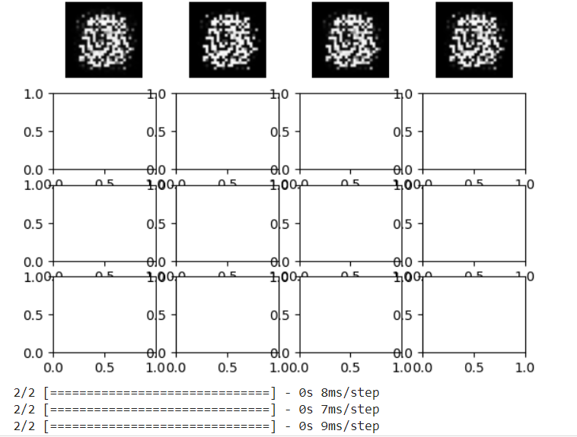
RESULTS

Slide 13
Evaluation
The Generative Adversarial Network (GAN) approach for handwritten digit recognition demonstrates promising results.
It achieves high accuracy in generating realistic digit images and enables a digit recognition model to perform effectively across various handwriting styles.
While computational efficiency and robustness are notable, further refinement may enhance its practical usability.

Slide 14
Conclusion
Our project successfully developed a Generative Adversarial Network(GAN) based Handwritten Digit Recognition
In leveraging Generative Adversarial Networks (GANs) for handwritten digit recognition, we've unlocked a powerful tool capable of generating realistic digit images and training effective recognition models.

